Slide 1
Call Center Efficiency
June 14, 2022

Slide 2





WELCOME
To Our Project
Call Center Efficiency

Slide 3
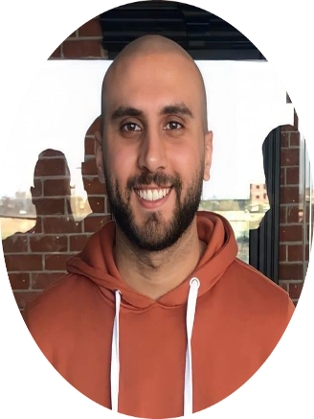
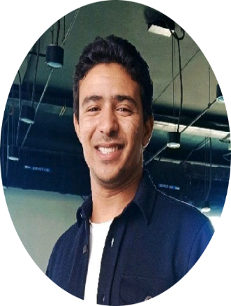


Moaz Abdulfattah
Marwan Diab
Ibrahim Emara
MustafaEl-araby

Slide 4
Agenda
01. Introduction
02. Analysis Scope
(EDA & Data Manipulation)
03. KPIs Definitions
04. Dashboard
05. Our Recommendations

Slide 5

Introduction
Analysing call center KPIs is imperative when assessing the effectiveness and efficiency of a call center.
Organizations are faced with several challenges:
-Decrease in customer satisfaction level which impacts the overall customer experience.
Reputational risk.
Potential customer and revenue loss
This dataset is stitched together from real-world data sources. CRM + core banking system.

Slide 6
Data Manipulation
Merge Data
Create new columns& flags
- Merge crm call center logs and events tables with left join.
- Calls Count : calls count for each phone number.
AHT : Avg handling time for all Employees.
Is Short Abend : if call duration < 10 s.
Is Reached : if call has vru line.
Replace columns values
Call Type column :
Outgoing Call (TT).
New Customer (NW).
Regular (PS).
Stock Transaction (NE).
Service in English (PE).
Ignore Columns
Hide consumer consent provided, consumer complaint narrative and sub issue columns.

Slide 7
Explore the Data
Time Frame
Date Received and Complaint ID
Has Nulls Values
There is no Complaints after first quarter of 2017
Many call < 10 s.
All Calls in duration between 9 Am and 5 PM.
Complaint ID, Client ID, Vru L, priority , outcome , Employee Code.

Slide 8

KPIs

Slide 9
AHT ( Average Handling Time)
AVERAGE HANDLE TIME (AHT)
Formula
Handling Time
(Talk Time + Hold Time + ACW Time)
0:09:21
Total Answered Calls

Slide 10
Timely Response
Timely Response %
Formula
Answered Calls on time
95.00%
Total Answered Calls

Slide 11

First call resolution
First call resolution
66%
Formula
Calls resolved in first time
Total Calls

Slide 12

Consumer Disputed %
Consumer Disputed %
16%
Formula
Consumer Disputed Calls
Total Answered Calls

Slide 13




STATUS
_{Employees}
26
_{Total Calls}
3999
_{Total Reached Calls}
2716
_{Total UnReached Calls}
885
_{Short Calls (<10s)}
402

Slide 14
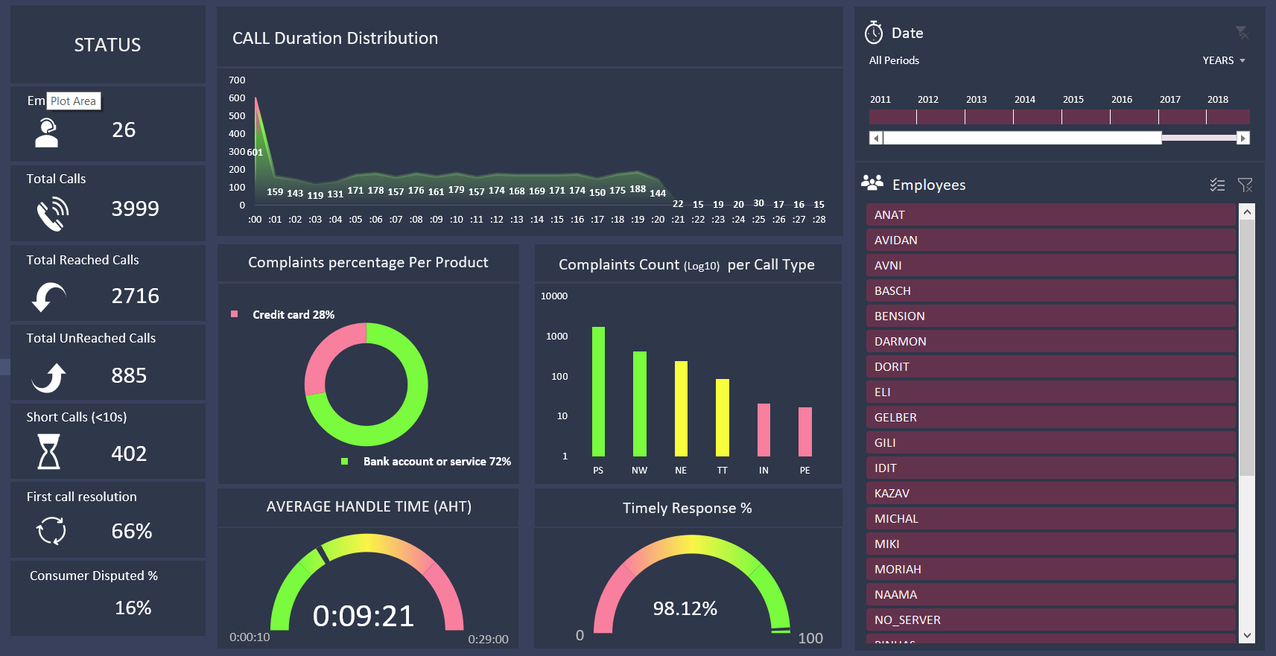
Dashboard

Slide 15
Our Recommendations
What is the problem faced the CSTs in bank acc. service? And how can we solve it in easy way?
Hire new employees to reduce the problem of not reached calls.
Configure the cause of the short calls (< 10 sec.)!
HR investigation for the top 5 employees in consumer disputed .

Slide 16

Thank you

